Slide 1
ETHER LORDS FAKE NEWS DETECTION USING MACHINE LEARNING.

Slide 2
IDEA/PROBLEM STATEMENT.
Fake news and lack of trust in media is a huge problem in our society. Fake news is a purposely misleading story which can be used by media or people to create panic or deceive someone.
It is sometimes used to dismiss the facts counter to their preferred viewpoints. Fake news detection on social media present unique characteristics and challenge that make existing detection algorithm from traditional news media ineffective or not applicable.
Fake news is intentionally written to mislead readers to believe false information.

Slide 3
PROPOSED SOLUTION.
As you can see this needs to be fixed. Our Model tries to fix this. The main objective is to detect the fake news, a classic text classification problem . It is needed to build a model that can differentiate between “Real” news and “Fake” news.
A Front-End website is made where the user can input text from the data set and the authenticity of the news can be verified.
The result webpage also has links to four other reliable news websites which provide real time news.

Slide 4
IMPLEMENTATION DETAILS WITH TECH STACK
Jupyter notebook – Back-End development.
Html – Front-End development.
CSS – Front-End development.
Python – Back-End development.
Javascript.
Machine learning with a 'PassiveAggressiveClassifier' model was used to develop the Back-End.
Prewritten dataset news.csv was used as the primary dataset to implement machine learning in the learning algorithm. The Back-End was developed using jupyter notebook and a python program.

Slide 5
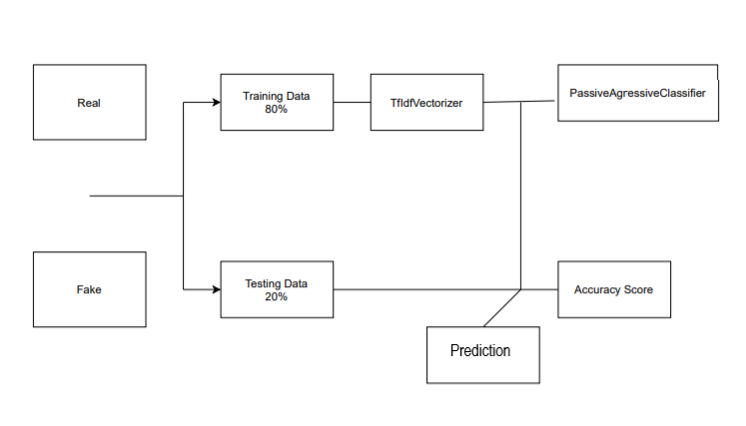

Slide 6
WOW FACTOR
Animated background.
Extra features:
-displays system time of the user
- links major websites such as BBC, CNN, TOI, to read real time news.
- links major resources websites for Corona Virus in India.
- links WHO website international stats on Corona Virus.

Slide 7
FUTURE WORK
We feel that improvising and increasing the size of the data set is necessary. As more data would be beneficial in increasing the accuracy of our model, like including real time news which makes the model even more useful as it is not limited to old datasets.
Trying to implement concepts like :
- Word2Vec: The Word2Vec technique converts text to features while maintaining the original relationships between words in a corpus.
-Topic Modelling: It categories each piece of text into topics and can make accurate predictions.

Slide 8


